Slide 1
Power BI | MS Fabric
Here you can fine Realtime interview questions

Slide 2
As a Data Analyst at our company, you will be responsible for leveraging Power BI to provide data-driven insights. Considering the importance of Dynamics RLS and on-prem Power Report Server, please explain a project where you successfully implemented these features to enhance data security and reporting capabilities.
Project: Enhanced Data Security and Reporting with Power BI
Implemented Dynamic Row-Level Security (RLS) to restrict data access based on user roles
Utilized on-premises Power Report Server for secure data handling within the client's infrastructure
Ensured sensitive data remained private and compliant with data privacy regulations
Empowered stakeholders with personalized, accurate reports while maintaining strict data security measures.

Slide 3
Can you provide an example of a situation where you had to troubleshoot and resolve a data connection issue in Power BI?
Data connection issue in Power BI with an external database dataset not refreshing.
Identified expired credentials as the cause of the connection failure.
Updated credentials and tested the connection successfully.
Scheduled automatic refreshes to ensure up-to-date dataset.
Collaborated with IT team and data source administrators for smooth resolution and uninterrupted access to critical data.

Slide 4
Can you describe a project where you had to analyze a large dataset using Power BI and provide actionable insights to drive business decisions?
I imported and transformed the dataset to create meaningful visualizations and dashboards.
Identified key performance indicators (KPIs) like sales trends, top-selling products, and customer segmentation.
Utilized Power BI's interactive features to drill down into specific data points for deeper insights.
Discovered correlations between marketing campaigns and sales spikes, leading to optimized advertising strategies.
Presented the findings to stakeholders, enabling data-driven decisions to improve inventory management, marketing efforts, and overall profitability.

Slide 5
Tell me about a time when you had to collaborate with multiple stakeholders to gather requirements and deliver a Power BI solution that met their needs.
Conducted meetings and workshops to gather requirements and understand their specific reporting needs.
Designed interactive dashboards that provided insights into sales performance, marketing ROI, and inventory management.
Iteratively refined the solution based on stakeholders' feedback and insights.
Ensured data accuracy and reliability by working closely with IT and data administrators.
The collaborative approach resulted in a comprehensive Power BI solution that met stakeholders' needs, enabling data-driven decisions and fostering a better understanding of the business's performance across departments.

Slide 6
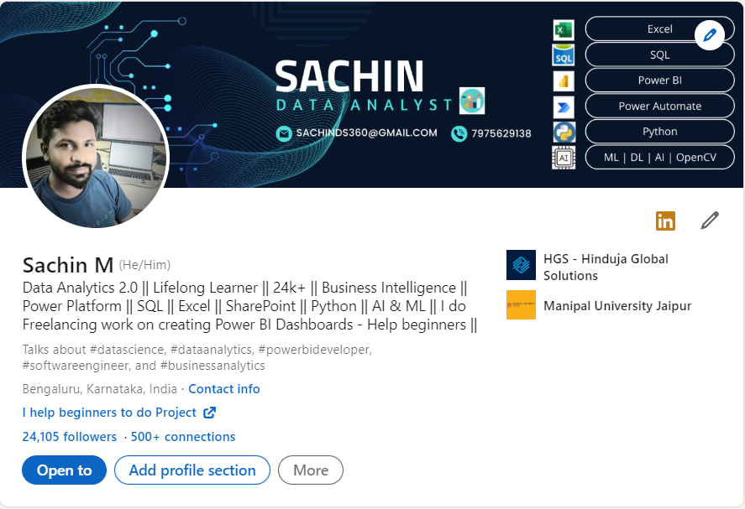
Thank you Connect me on LinkedIn & GitHub

